Slide 1

Prediction modeling of chronic heart diseases
A comparative study on different algorithms
Group 11

Slide 2
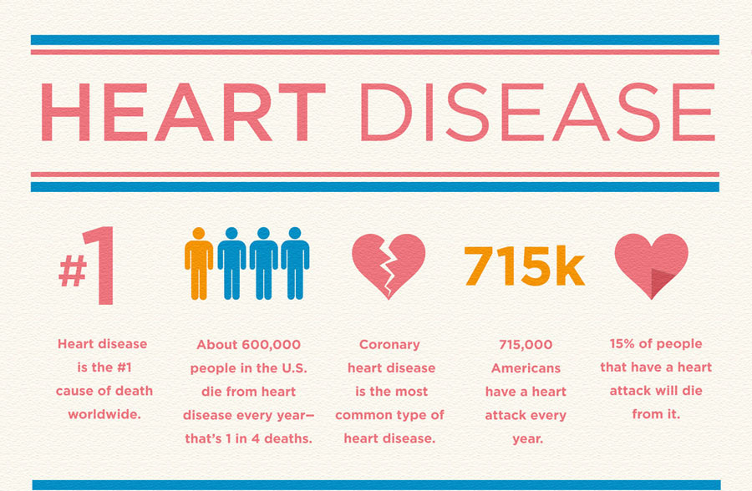
Introduction
Early detection of cardiac diseases can decrease the mortality rate and overall complications.
We are going to use an existing dataset from the UCI Machine learning repository containing 76 medical attributes, but all published experiments refer to using a subset of 14 of them. In particular, the Cleveland database is the only one that has been used by ML researchers to this date.
Our goal is to run this model through different classifiers to see which one has the highest accuracy which we came across as popular choices during our topic research.
Notes:
Heart disease is a major cause of concern throughout the world and is said to be one of the main cause of death amongst humans by WHO.

Slide 3

Methodology

Slide 4
Strategy
Understanding dataset
Checking accuracy
Tuning model using cross validation
Using additional evaluation metrics to determine

Slide 5
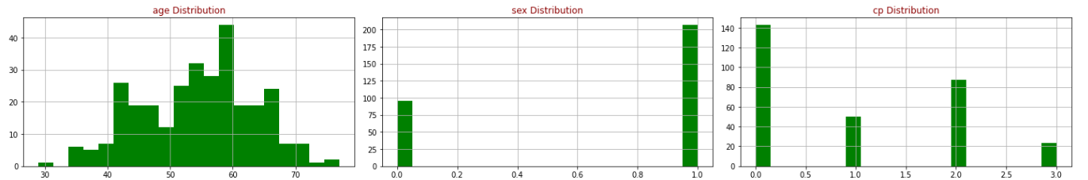
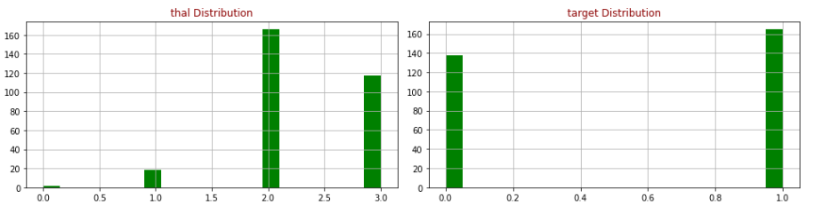
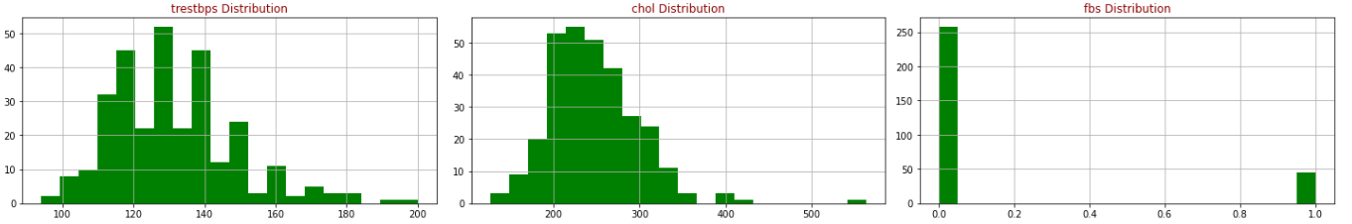
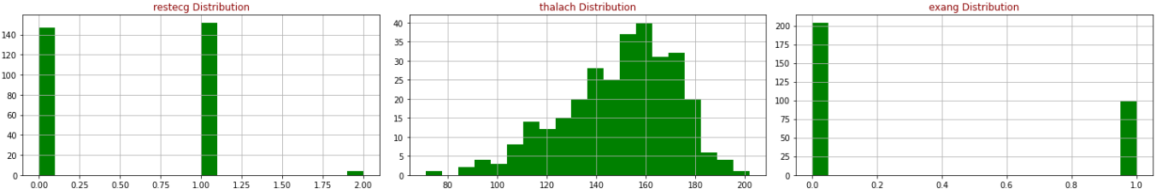
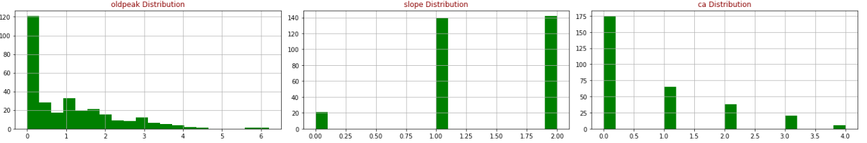
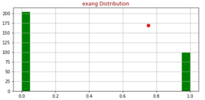
Data Visualization
Notes:
We have chosen one of the popular datasets for Heart Disease we came across on Kaggle through the UCI Machine learning repository. In this, we are sticking to the Cleveland database which is widely used among ML researchers according to their website. Our goal with this dataset is to correctly classify whether a patient has heart disease or not using the 14 parameters out of the total 75 in the dataset which we have mentioned below. For this project, the dataset was taken in csv format from Kaggle and will be split into two: a training and a testing set. The goal will be to get the best predictor and guess if a patient has a heart disease.

Slide 6
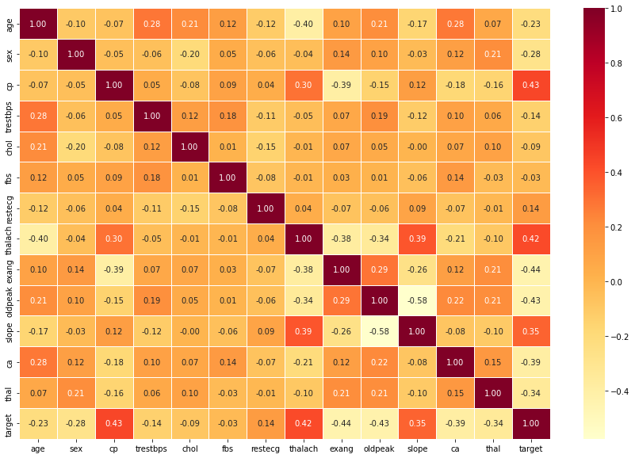
Correlation matrix
cp, thalach and slope have the strongest positive correlation with target,exang, oldpeak and ca the strongest negative corr.
It shows that there is no single feature that has a very high correlation with our target value. This makes sense because when you exercise, your heart requires more blood, but narrowed arteries slow down blood flow.
Also, some of the features have a negative correlation with the target value and some have positive

Slide 7
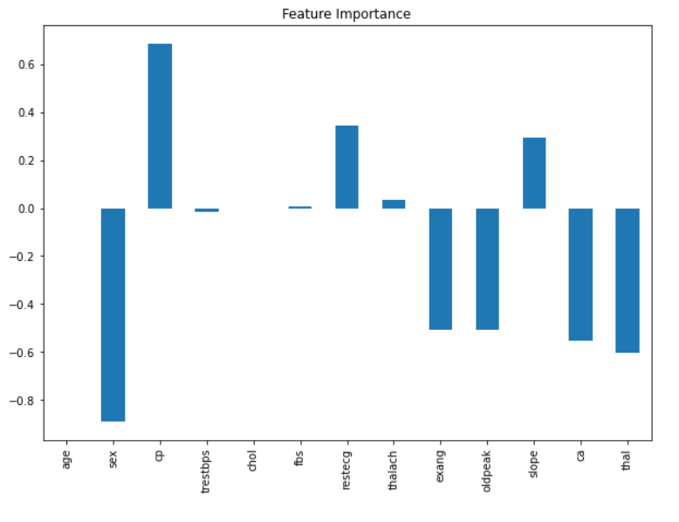
Feature Importance

Slide 8
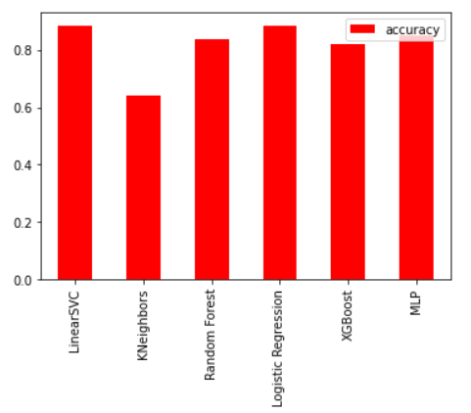
Model comparison before tuning
LinearSVC' | 0.8852459016393442
KNeighbors | 0.639344262295082
Random Forest | 0.8360655737704918
Logistic Regression | 0.8852459016393442
XGBoost | 0.819672131147541
MLP | 0.8524590163934426

Slide 9
Cross Validation to tune model
We then perform 5-Fold cross validation to better tune each model since they have low accuracy.
After performing it, we notice that the prediction accuracy increases significantly for:
Logistic regression: 0.90
Random Forrest: 0.88
XGBoost: 0.86

Slide 10
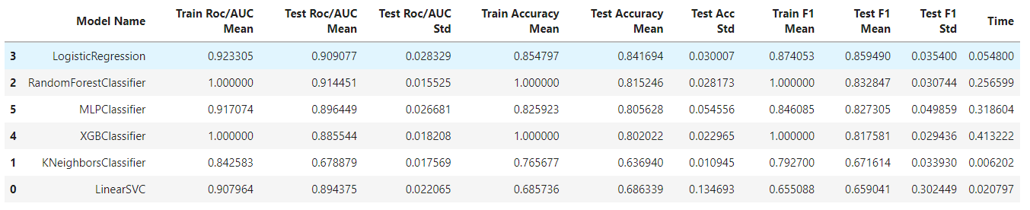
Comparative study of different ML models
Notes:
Let us no look at some of the evaluation metrics

Slide 11
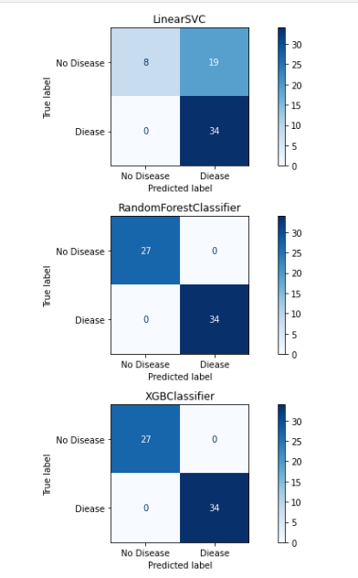
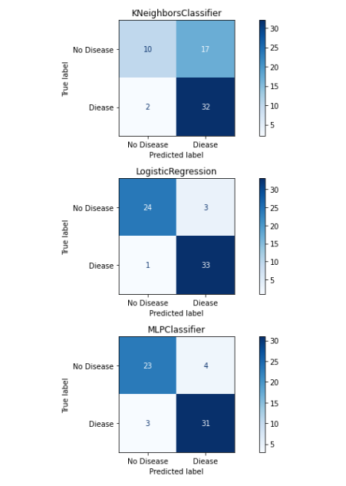
Confusion Matrix

Slide 12
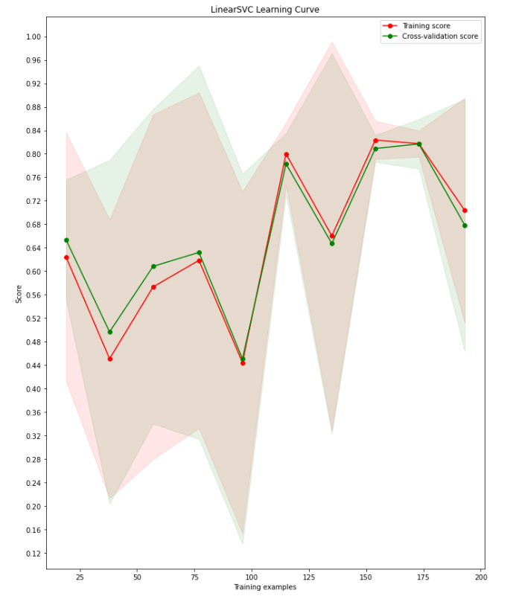
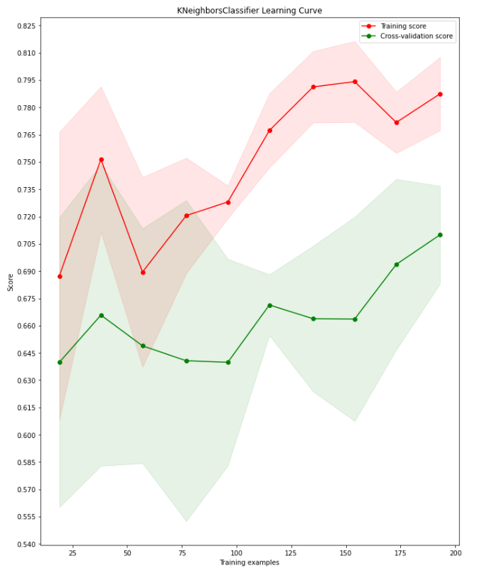
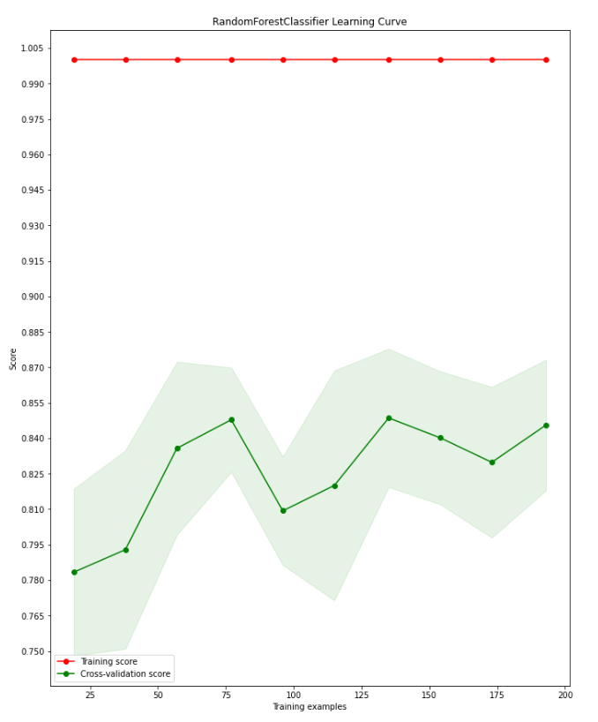
Learning Curve
LinearSVC
KNeighbours classifier
Random forest classifier

Slide 13
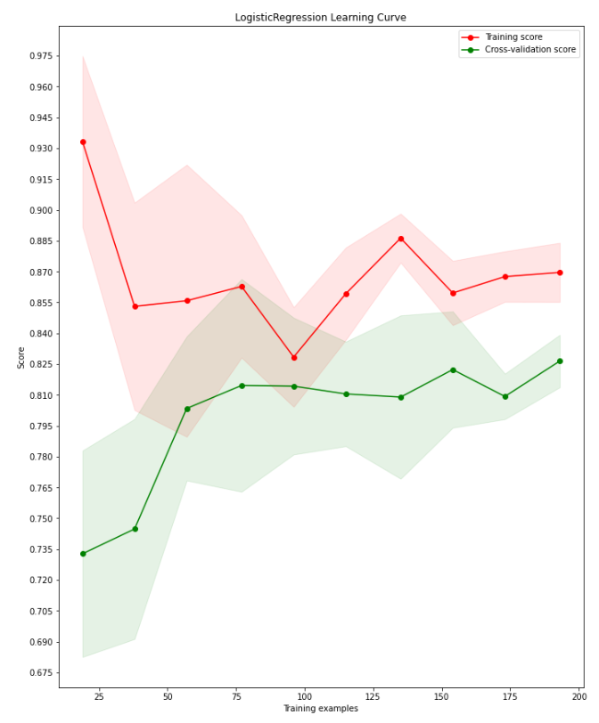
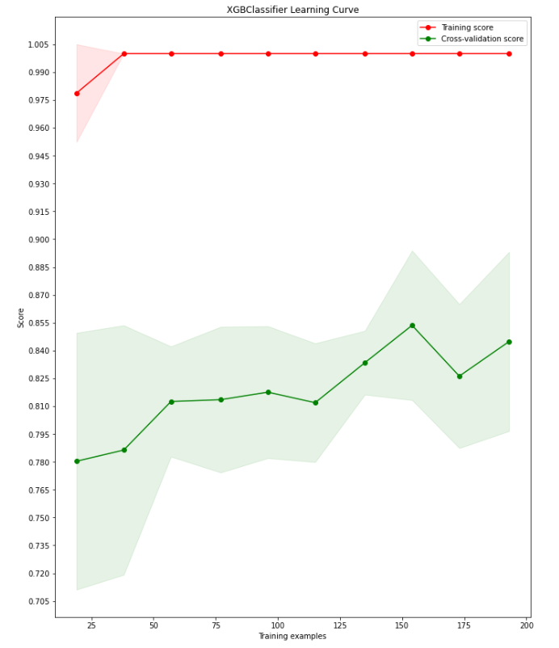
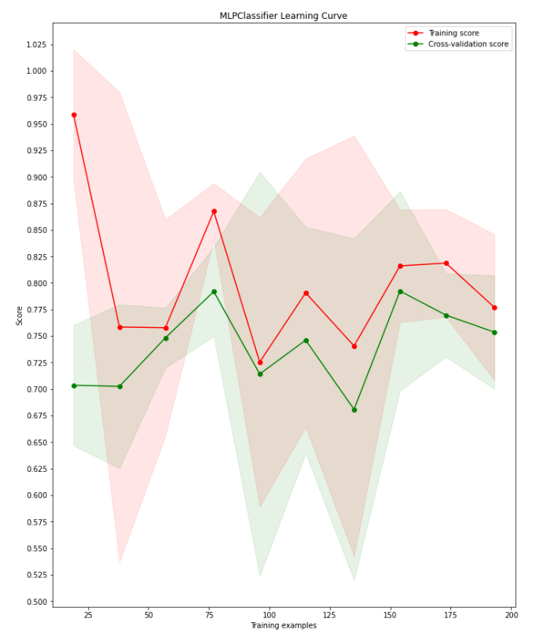
Logistic regression
XGboost classifier
MLP classifier

Slide 14
Conclusion
We have achieved a prediction accuracy of about 90% for Logistic regression, Random forest and XGBoost.
XGBoost (Extreme Gradient Boosting) model was used as it is a better model generally for classification, regression and ranking problems.
Although speaking in terms of medical standards, it might not seem that good, but our model does predict a heart disease correctly 9 out 10 times
Scope of improvement:
Find better dataset
Improve model parameters with more careful tuning to check if further improvement can be achieved.

Slide 15

Thank you

